Slide 1

Colorado Comprehensive Health Education Standards
Preschool
Notes:
Colorado has established Comprehensive Health Education Standards for grades Pre-K-12. Health education standards are intended to help prepare students with information they need in order to be successful using 21st century skills in our global economy. Mastery of the concepts and skills within a standard means that a student has facility with a skill or concept in multiple contexts. This PowerPoint will familiarize you with the Preschool standards.

Slide 2

Comprehensive Health Education Standards
Physical & Personal Wellness
Emotional & Social Wellness
Prevention & Risk Management
Notes:
There are three comprehensive health education standards for every grade level PreK-12. They are Physical & Personal Wellness, Emotional and Social Wellness, and Prevention & Risk Management. Each standard has defined grade level expectations. These grade level expectations scaffold upon each other to prepare students to graduate into the “real” world armed with the skills and concepts necessary to maintain personal health and wellness. These are skills that students will use throughout their lifetime. In addition, when students learn to apply and use these skills, they will be more successful academically and will be more likely to reach personal and career goals. The Comprehensive Health Education Standards are clearly in line with the Center School District core belief that we are preparing our students to be successful in life.

Slide 3
Physical & Personal Wellness
Prepared Graduate Competencies
  Participate regularly in physical activity
  Achieve and maintain a health-enhancing level of physical fitness
  Apply knowledge and skills to engage in healthy eating
  Apply knowledge and skills necessary to make personal decisions that promote healthy relationships and sexual and reproductive health
  Apply knowledge and skills related to health promotion, disease prevention, and health maintenance
Notes:
Prepared Graduate Competencies define the skills and concepts Center High School graduates will utilize as an outcome of mastery of the Comprehensive Health Education Standards taught grades PreK-12.
Prepared Graduates in the Physical and Personal Wellness standard will participate regularly in physical activity, achieve and maintain a health-enhancing level of physical fitness, apply knowledge and skills to engage in lifelong healthy eating, apply knowledge and skills necessary to make personal decisions that promote healthy relationships and sexual and reproductive health, and apply knowledge and skills related to health promotion, disease prevention, and health maintenance.

Slide 4
Grade Level Expectations
STANDARD:
Physical and Personal Wellness
1. Develop self management skills and personal hygiene skills to promote healthy habits
Notes:
Grade level expectations are defined for each standard. Grade level expectations describe concepts and skills the student must master for that school year. For students in preschool, for the Physical and Personal Wellness standard, students are expected to be able to [READ SLIDE]

Slide 5
Grade Level Expectations
STANDARD:
Physical and Personal Wellness
1. Develop self management skills and personal hygiene skills to promote healthy habits
  Prepared Graduates: Apply knowledge and skills related to health promotion, disease prevention and health maintenance
  Evidence Outcomes:
  Students can:
  a) Develop an awareness of healthy habits such as using clean tissues, washing hands, handling food hygienically, brushing teeth, and dressing appropriately for the weather
Notes:
Each grade level expectation relates back to the Graduate Level Competencies for its standard. In addition, each expectation has a list of evidence outcomes to demonstrate mastery. For the standard Physical and Personal Wellness, the first expectation was to [READ STANDARD]. This will ensure that prepared graduates will be able to [READ PREPARED GRAD] How do we know that a student in preschool has mastered this grade level expectation? [READ EVIDENCE OUTCOMES]

Slide 6
Emotional & Social Wellness
Prepared Graduate Competencies
  Utilize knowledge and skills to enhance mental, emotional, and social well being
  Exhibit responsible personal and social behavior that respects self and others
Notes:
Prepared Graduate Competencies define the skills and concepts Center High School graduates will utilize as an outcome of mastery of the Comprehensive Health Education Standards taught grades PreK-12.
Prepared Graduates in the Emotional and Social Wellness standard will utilize knowledge and skills to enhance mental, emotional & social well being, and exhibit responsible personal and social behavior that respects self and others.

Slide 7
Grade Level Expectations
STANDARD:
Emotional & Social Wellness
There are no specific expectations for this grade level standard
Notes:
For students in preschool, for the Emotional and Social Wellness standard, there are no expectations for this level.

Slide 8
Prevention & Risk Management
Prepared Graduate Competencies
  Apply knowledge and skills to make health-enhancing decisions regarding the use of alcohol, tobacco, and other drugs
  Apply knowledge and skills that promote healthy, violence free relationships
  Apply personal safety knowledge and skills to prevent and treat intentional or unintentional injury
Notes:
Prepared Graduate Competencies define the skills and concepts Center High School graduates will utilize as an outcome of mastery of the Comprehensive Health Education Standards taught grades PreK-12.
Prepared Graduates in the Prevention and Risk Management standard will apply knowledge and skills to make health-enhancing decisions regarding the use of alcohol, tobacco and other drugs, apply knowledge and skills that promote healthy and violence free relationships, and apply personal safety knowledge and skills to prevent and treat intentional or unintentional injury.

Slide 9
STANDARD:
Prevention & Risk Management
Grade Level Expectations
1. Identify ways to be safe while at play
Notes:
The grade level expectations for the Prevention and Risk Management standard are that the student is able to identify ways to be safe while at play.

Slide 10
Grade Level Expectations
STANDARD:
Prevention & Risk Management
1. Identify ways to be safe while at play
  Prepared Graduates: personal safety knowledge and skills to prevent and treat unintentional injury
  Evidence Outcomes:
  Students can:
  a) State how to be a safe pedestrian
  b) Identify ways to reduce injuries on the playground
Notes:
This grade level expectation for the Prevention and Risk Management is to identify ways to be safe while at play. [READ EXPECTATION]. Prepared graduates should have personal safety knowledge and skills to prevent and treat unintentional injury. Evidence outcomes for this expectation are that the student be able to state how to be a safe pedestrian and to identify ways reduce injuries on the playground. [READ EVIDENCE OUTCOMES]

Slide 11
Comprehensive Health Education
Preschool at a Glance
GRADE LEVEL EXPECTATIONS
Self Management
Personal Hygeine
No Specific Standards for this Grade Level
Playing Safe
STANDARD:
Physical & Personal Wellness
Emotional & Social Wellness
Prevention & Risk Management
Notes:
This is a slide of the preschool grade at a glance.

Slide 12
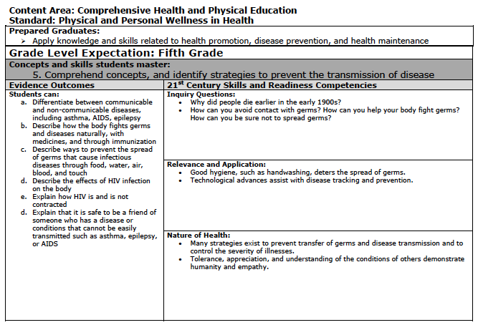
Academic Standards Template
GRADE LEVEL EXPECTATION: Skills & concepts students at this grade should master in progress toward graduation
STANDARD: One of 3
PREPARED GRADUATE COMPETENCYWhat students will be able to do when they graduate.
INQUIRY QUESTIONS: Promote critical thinking
EVIDENCE OUTCOMES: Indicators of student mastery
RELEVANCE & APPLICATION: Relevant societal
context
NATURE OF HEALTH:
Characteristics of discipline
Notes:
The health standards are listed in the Comprehensive Health & PE Standards document. This is the standard document template. Each grade level expectation for the standards is listed in this format in the document. Through this PowerPoint, we have covered most of the information included in these tables. The standard is at the top of the page. The graduate level competency is then listed below the standard. Next, you will see the grade level expectation. For this grade level expectation, the evidence outcomes are listed. The column to the right includes resources and information to help with teaching the expectation. These include inquiry questions, relevance and application, and nature of health.

Slide 13
HOW ARE YOU ABLE TO DO THIS WITHOUT A DEDICATED HEALTH CLASS?
Content Integration
Familiarize yourself with the standards.
Find ways to integrate the standards into other academic disciplines.
Make healthy messages a part of your classroom culture .
Utilize the language of health education throughout the school day.
Encourage the use of skills learned through health education in your classroom.
Utilize the resources at http://colegacy.org/comprehensive-pe-and-health-standards/teach-it/ and at http://www.cde.state.co.us/sitoolkit/ for ideas for teaching health education and for integrating health education into other content areas.
Access the help of your health education coordinators.
Are you
feeling
Overwhelmed
?
Notes:
(This page is specific to the elementary, but can be revised slightly as a resource page for MS & HS.)
So, how do you effectively implement these standards without a dedicated health education class. Are you feeling a bit overwhelmed? We understand that it may even be impossible to implement with complete fidelity and mastery all of these standards given the other demands on class time. However, given the importance of health education to not only the health of the students, but also their academic success and future realization of goals, it is important that we attempt to provide as much health education as possible. In fact, health education can be even more impactful when integrated into other content areas. So, you can first become familiar with the standards. You have begun this process by listening to this PowerPoint. Thank you! Next, find ways to integrate the standards into other academic disciplines that you teach. Make healthy messages a part of your classroom culture. Utilize the language of health education throughout the school day. Encourage the use of skills learned through health education in your classroom. Finally, utilize the resources at the links provided for ideas about teaching to the health education standards as well as how to integrate into other academic disciplines. Included in these links are concept maps that link to the other content areas and their standards. Finally, please do not hesitate to access the help of your health education coordinators—Katrina Ruggles, Marsha Felmlee, and Carla Smith. All three have had extensive training in the implementation of the health standards across the grade levels.

Slide 14
Thank you & Evaluation
We are preparing students to be successful in life!
Please take the post-test at the link below:
https://www.surveymonkey.com/s/DJZT52H

